Slide 1
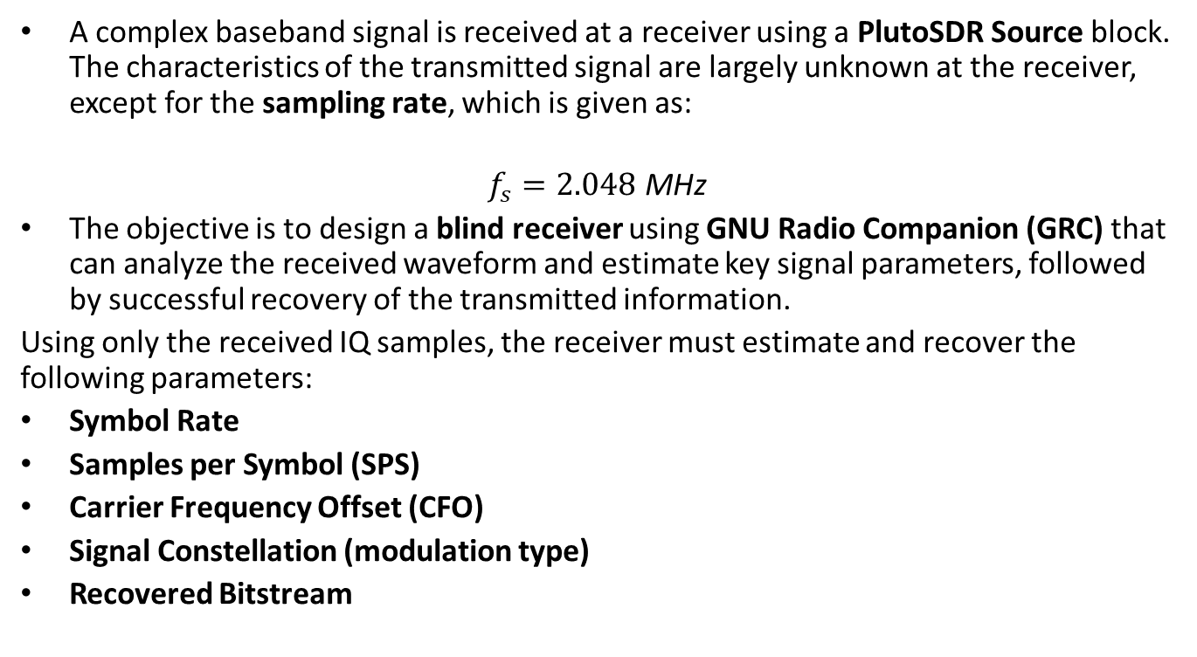
PLUTO SDR Receiver Design
A complex baseband signal is received at a receiver using a PlutoSDR Source block. The characteristics of the transmitted signal are largely unknown at the receiver, except for the sampling rate, which is given as:
$$f_{s}=2.048 \text{MHz}$$
The objective is to design a blind receiver using GNU Radio Companion (GRC) that can analyze the received waveform and estimate key signal parameters, followed by successful recovery of the transmitted information.
Using only the received IQ samples, the receiver must estimate and recover the following parameters:
Symbol Rate
Samples per Symbol (SPS)
Carrier Frequency Offset (CFO)
Signal Constellation (modulation type)
Recovered Bitstream

Slide 2
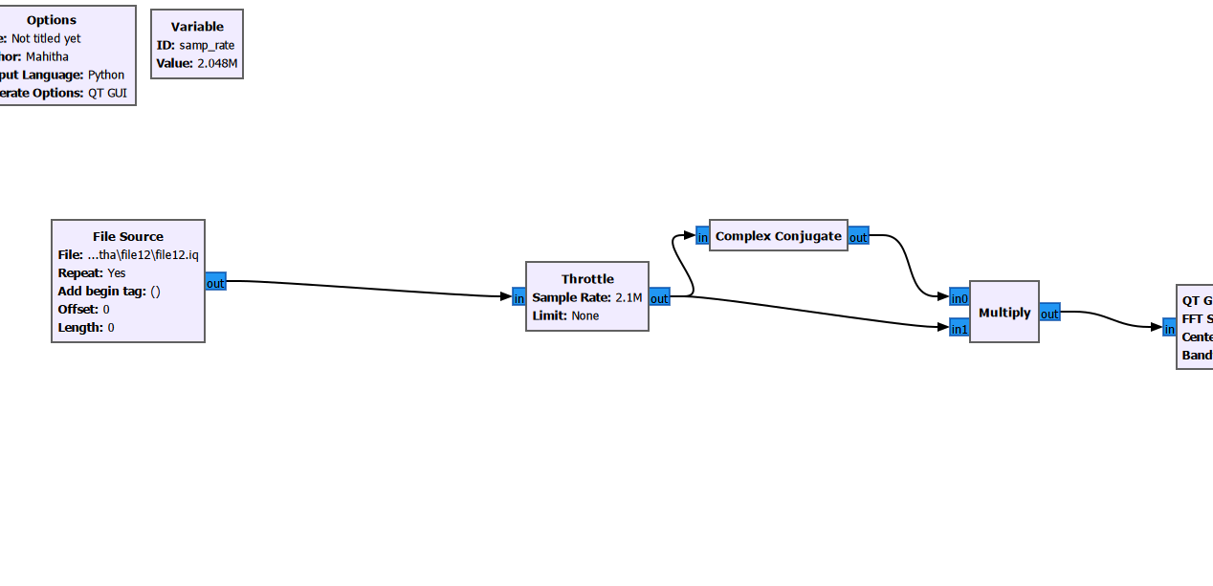
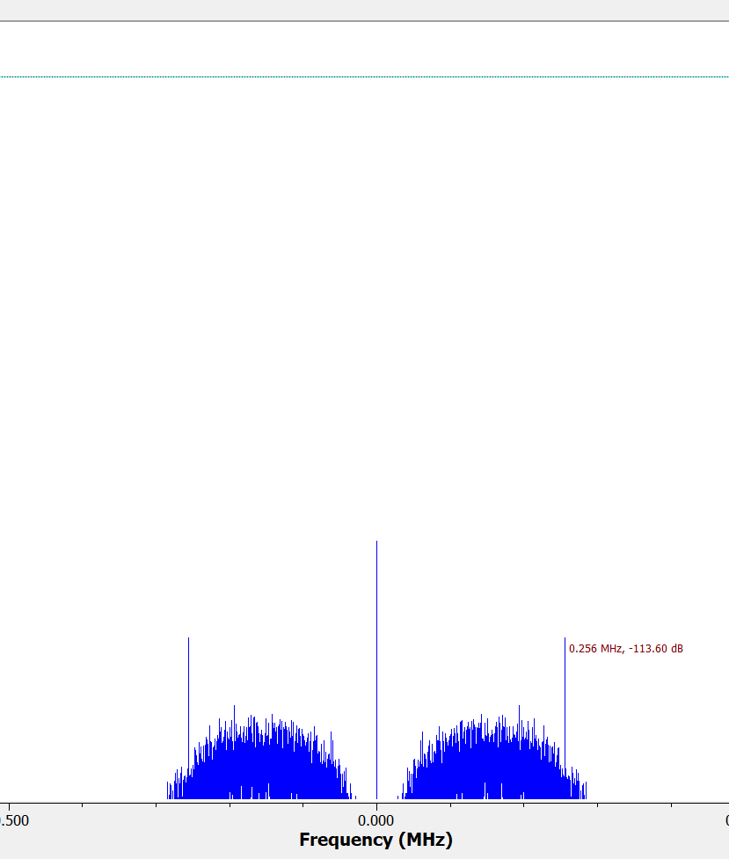
Symbol Rate & SPS Estimation
Method: x(t)·x*(t) → |x(t)|²
• Removes phase & frequency
• Periodicity reveals symbol rate
Result:
Symbol Rate ≈ 256 kHz(peak)
SPS = 2048k / 256k = 8

Slide 3
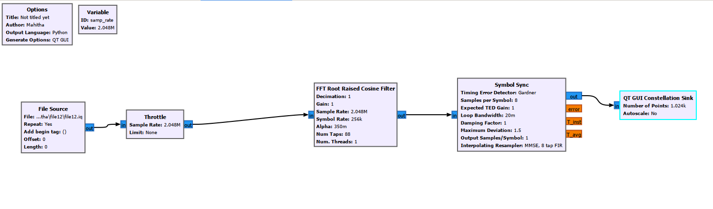
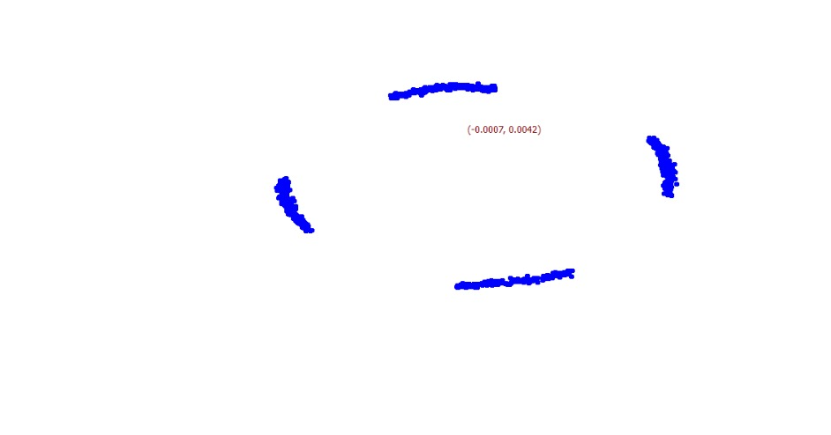
Constellation Estimation
Without CFO correction:
• Constellation rotates
• 4 points observed
Inference:
QPSK or 4-QAM

Slide 4
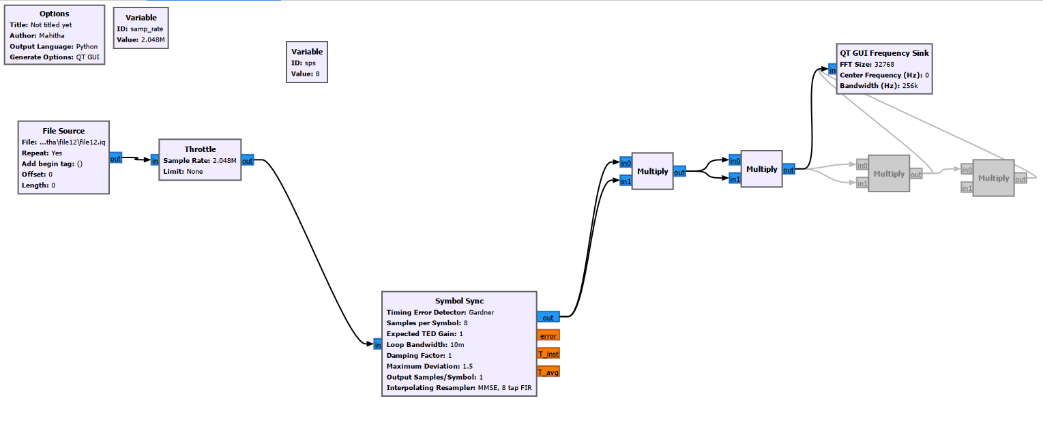

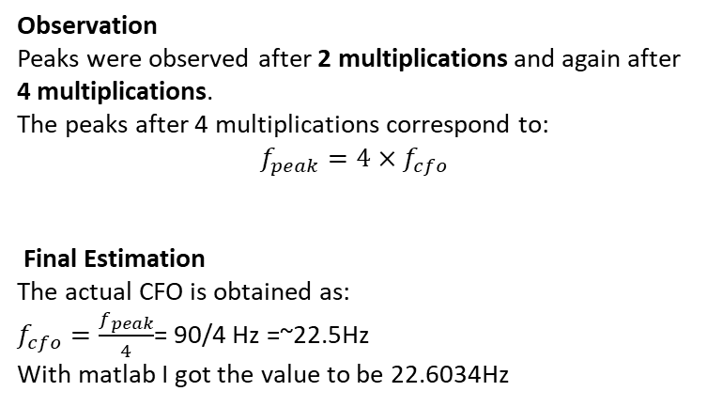
CFO Estimation
Method: Raise signal to power
Implementation
In GNU Radio, this is achieved using successive Multiply blocks to compute:
$x^{2}\left(t\right)$( 2multiplications
$x^{4}\left(t\right)$(4multiplications
The resulting signal is then passed to a Frequency Sink (FFT).
Observation
Peaks were observed after 2 multiplications and again after 4 multiplications.
The peaks after 4 multiplications correspond to:
$$f_{peak}=4×f_{cfo}$$
Final Estimation
The actual CFO is obtained as:
$f_{cfo}=\frac{f_{peak}}{4}$= 90/4 Hz =~22.5Hz
With matlab I got the value to be 22.6034Hz

Slide 5
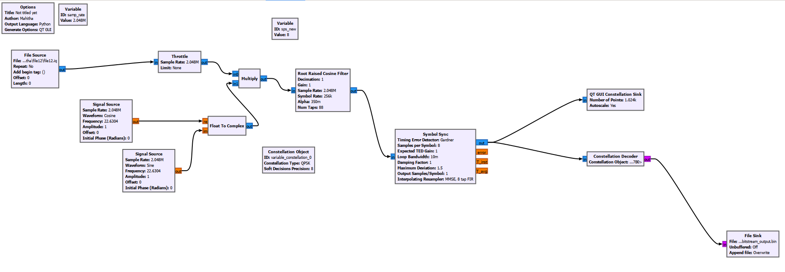
Final Receiver Design
Flow:
File → Throttle → CFO Correction → RRC → Symbol Sync → Decoder → File Sink
Blocks:
• CFO correction using complex exponential
• RRC for filtering
• Gardner TED for timing

Slide 6
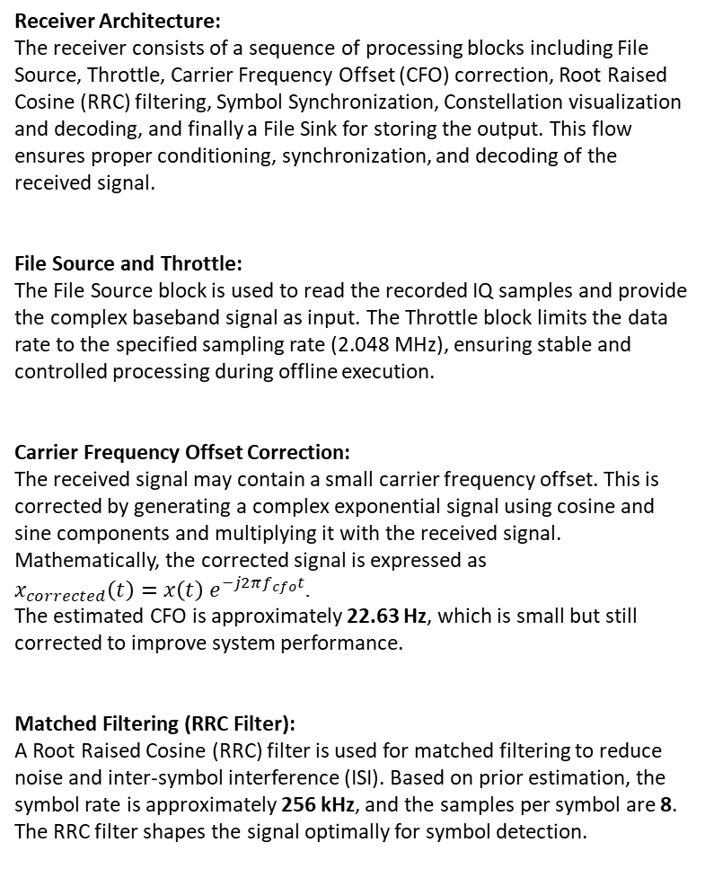
Receiver Architecture:
The receiver consists of a sequence of processing blocks including File Source, Throttle, Carrier Frequency Offset (CFO) correction, Root Raised Cosine (RRC) filtering, Symbol Synchronization, Constellation visualization and decoding, and finally a File Sink for storing the output. This flow ensures proper conditioning, synchronization, and decoding of the received signal.
File Source and Throttle:
The File Source block is used to read the recorded IQ samples and provide the complex baseband signal as input. The Throttle block limits the data rate to the specified sampling rate (2.048 MHz), ensuring stable and controlled processing during offline execution.
Carrier Frequency Offset Correction:
The received signal may contain a small carrier frequency offset. This is corrected by generating a complex exponential signal using cosine and sine components and multiplying it with the received signal. Mathematically, the corrected signal is expressed as $x_{corrected}\left(t\right)=x\left(t\right) e^{−j2πf_{cfo}t}$. The estimated CFO is approximately 22.63 Hz, which is small but still corrected to improve system performance.
Matched Filtering (RRC Filter):
A Root Raised Cosine (RRC) filter is used for matched filtering to reduce noise and inter-symbol interference (ISI). Based on prior estimation, the symbol rate is approximately 256 kHz, and the samples per symbol are 8. The RRC filter shapes the signal optimally for symbol detection.
Symbol Synchronization:
Symbol timing recovery is performed using the Gardner Timing Error Detector. This block aligns the sampling instants with the symbol boundaries and converts the signal to one sample per symbol, which is essential for accurate decoding.
Constellation Analysis and Decoding:
The QT GUI Constellation Sink is used to visualize the signal constellation. From the observed four distinct clusters, the modulation scheme is identified as QPSK. The Constellation Decoder then maps the received symbols to discrete values (0–3) based on the QPSK constellation.
Output Storage:
The decoded symbols are stored in a binary file using the File Sink block. Since bit repacking is not used, the stored output represents symbol values rather than individual bits. Each symbol corresponds to two bits in QPSK modulation.
Estimated Parameters:
The following parameters were successfully estimated from the received signal: sampling rate of 2.048 MHz, symbol rate of approximately 256 kHz, samples per symbol equal to 8, carrier frequency offset of approximately 22.63 Hz, and modulation identified as QPSK.

Slide 7
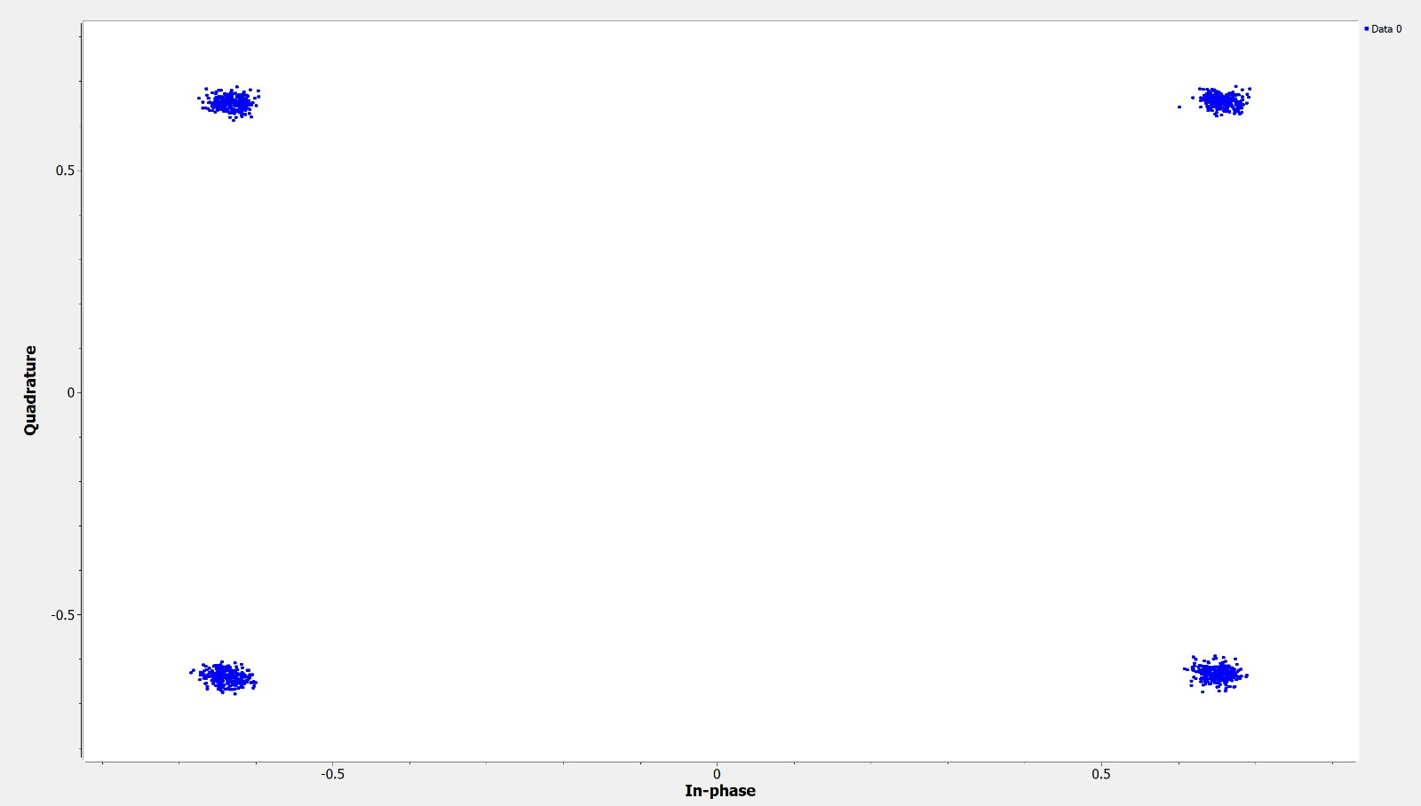
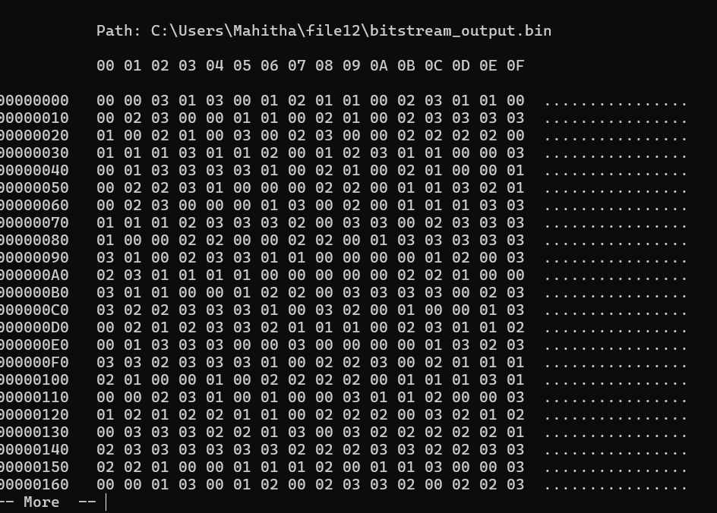
Results
Estimated Parameters:
• Symbol Rate: 256 kHz
• SPS: 8
• CFO: 22.63 Hz
• Modulation: QPSK
Output:
• Symbols stored (0–3)
• Each symbol = 2 bits

